Slide 1
Automatic Lens Smear Detection
YanBo Deng
Ruhui Shen
Rui Zou

Slide 2
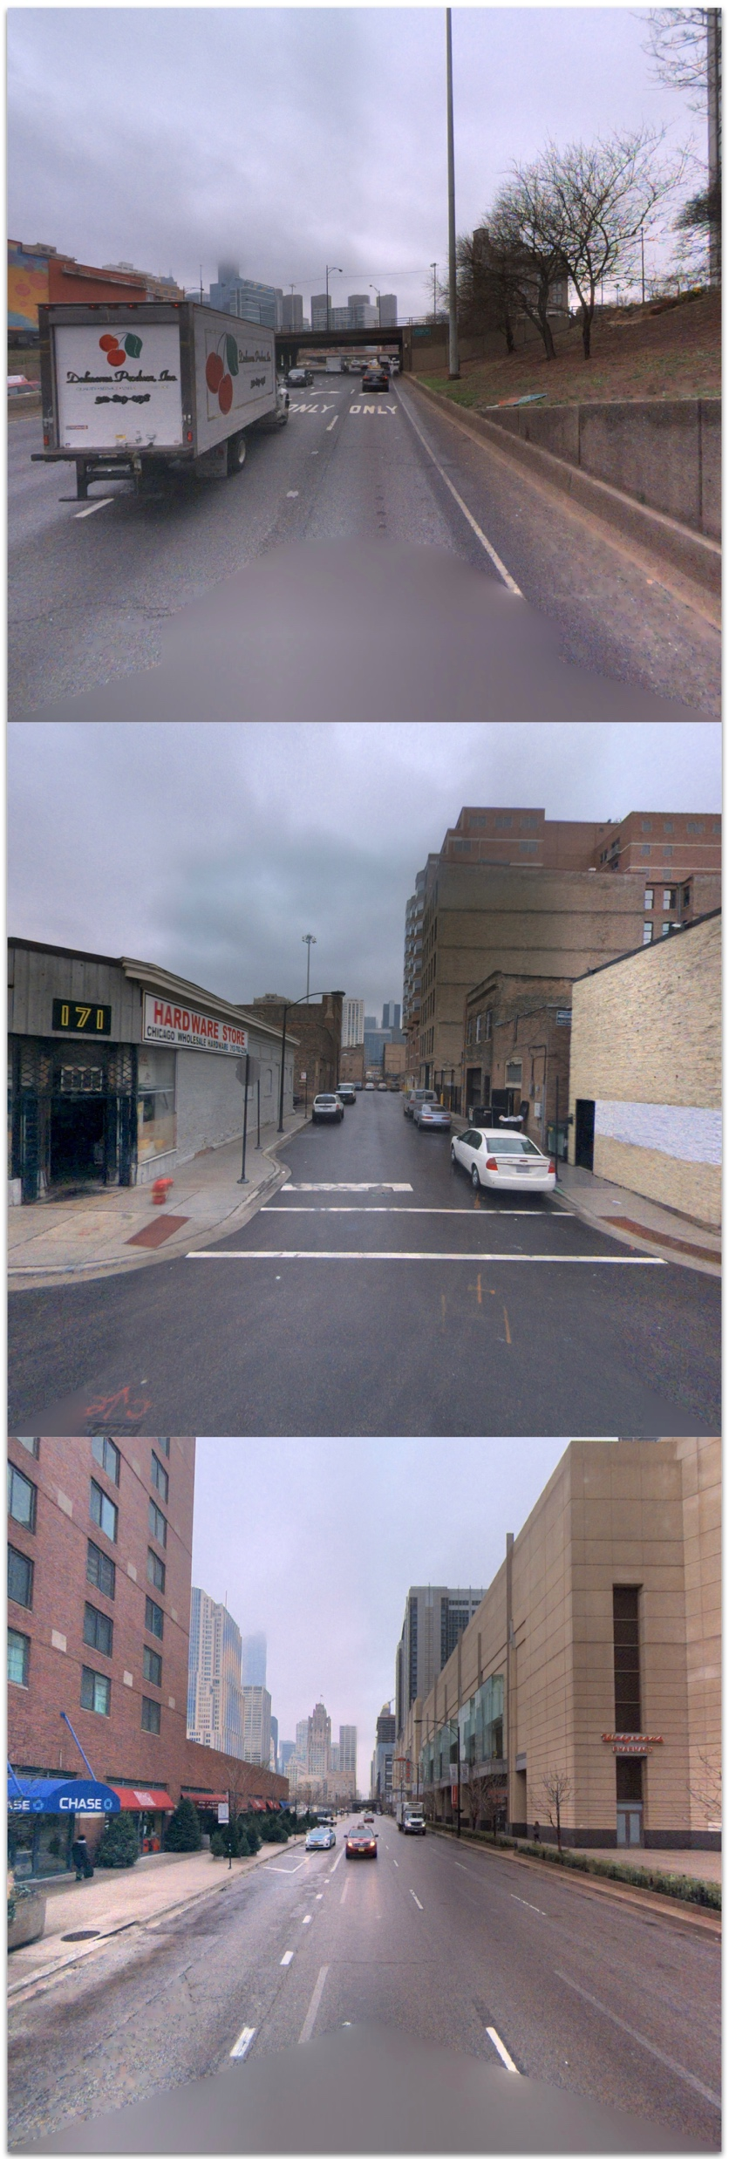
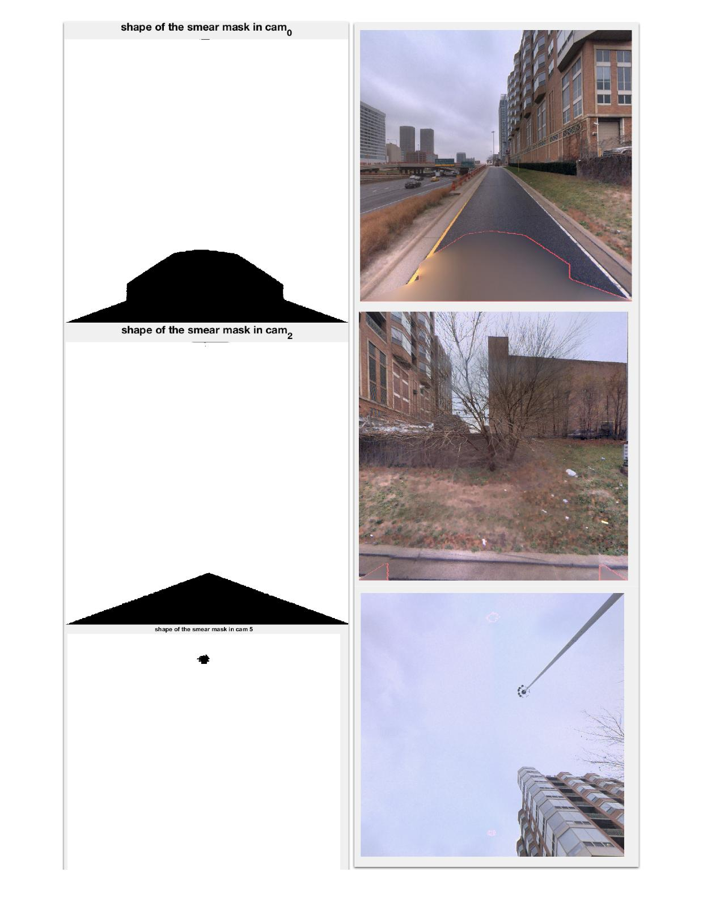
input
output

Slide 3
Content
Introduction
Our methods
Labelling
Process demo
Results

Slide 4
Introduction
The smear on the camera lenses caused by different reasons are not only an annoyance for photographers, but also a hindrance to computer vision and digital forensics.
Therefore, it is very important to preprocess the picture by remove the smear from the picture, which makes the detection become the first task. Smear will cause camera defocus and make these areas low-frequency, which gives us the power to detect the smear.

Slide 5
The characteristic of smear
Smear will blur some areas in the picture, the defocus blur for lens dirties so large that the artifacts are always presented as a low frequency pattern in images.
Smear is almost fixed on camera, so the amount of scattered light is fixed since the integral of the outside illumination is unchanged.

Slide 6
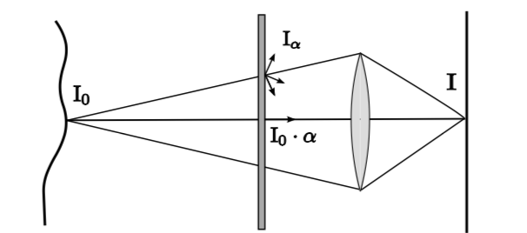
An intermediate cause by smear between the target scene and the camera lens affects the image irradiance in two ways:
(1)Attenuation
Where the scene radiance is reduced by absorption.
(2)Intensification
Where the intermediate layer itself will contribute some radiance to the image sensor by scattering the light from other directions.
"Removing Image Artifacts Due to Dirty Camera Lenses and Thin Occluders,"Â J. Gu, R. Ramamoorthi, P.N. Belhumeur and S.K. Nayar,Â ACM Transactions on Graphics (Proceedings of SIGGRAPH Asia)

Slide 7
Our three methods
Description | Method1 | Method2 | Method3
For each method, we work on R/G/B channels separately Finally add three channels up into one channel, and get one grayscale image | Compute intra-image gradient Find the first vale of the histogram as the threshold Generate binary image with the threshold | Compute intra-image gradient Compute the difference of neighbor-image gradient Find the first vale of the histogram as the threshold Generate binary image with the threshold | Compute pointwise maximum(Imax) and minimum(Imin) of each image pixels Compute the difference of the Imax and Imin and generate difference image Use the histogram to binarize the difference image

Slide 8
The method1: intra-gradient detection
For each image, calculate the gradient of each pixel
Then compute the average of the image gradient over all images to get the averaged image,
Generate the histogram of the averaged image and find the first vale of it as the threshold.
Smooth and binarize the averaged image with the threshold.

Slide 9
The method2: inter-gradient detection
For each image, calculate the gradient of each pixel
Compute the gradient difference of two continuous images
Then compute the averaged difference over all images to get the averaged image
Generate the histogram of the averaged image and find the first vale of it as the threshold.
Smooth and binarize the averaged image with the threshold.

Slide 10
The method3: detection from paper “dirtylens”
For each pixel, compute the pointwise maximum and minimum images (Imax and Imin)
Then compute the difference image (Imax – Imin)
Generate the histogram of the difference image and adaptively find the threshold
Smooth and binarize the averaged image with the threshold.

Slide 11
Comparison of three methods
 | Method1 | Method2 | Method3
advantage | The overall result is better than the others | Have fewer false negatives | Run faster, less computational complexity.
disadvantage | Have more false negatives | Have more false positives | The boundary is hazy and has some false positives

Slide 12
Labelling
Clean
Remove noise in the mask by removing small isolated objects.
Contour
Use bwmorph of MATLAB to find the contour of the mask area.
Mask
Add the contour mask to the original street view image.

Slide 13
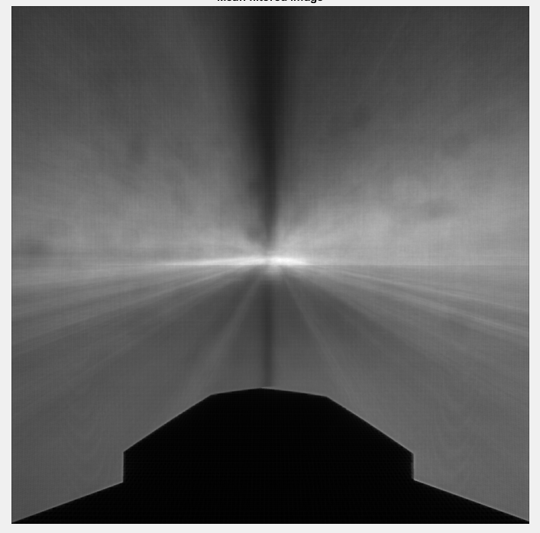
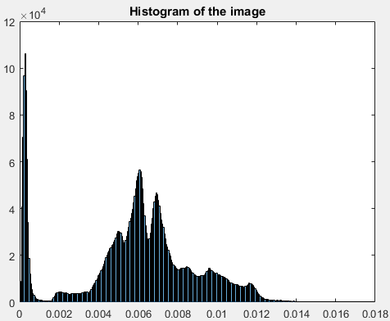
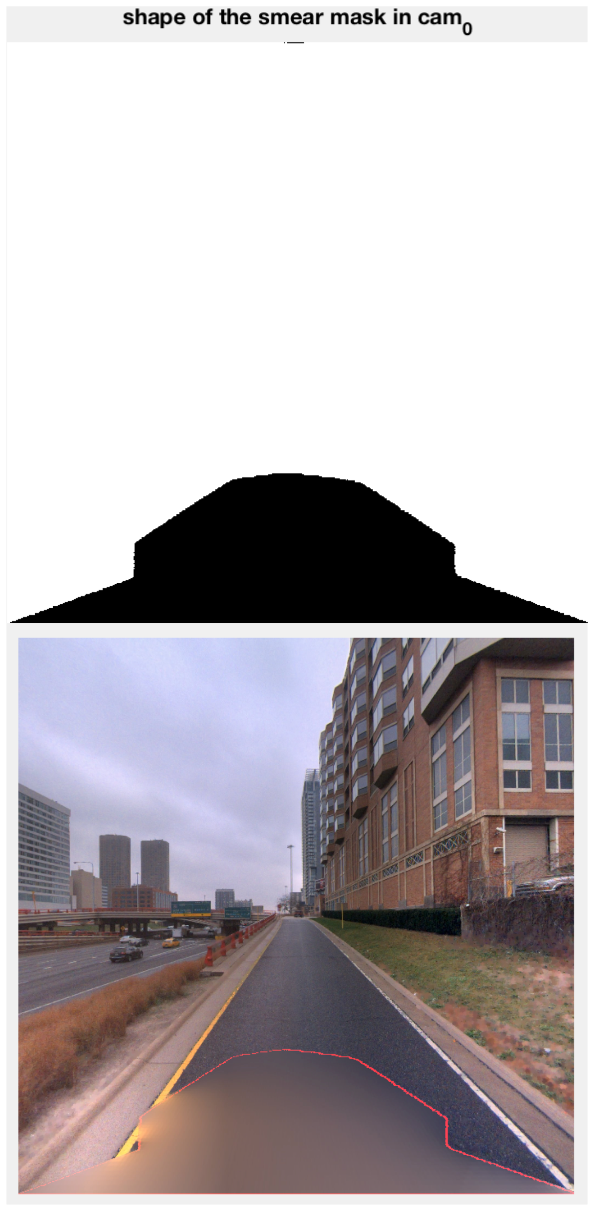
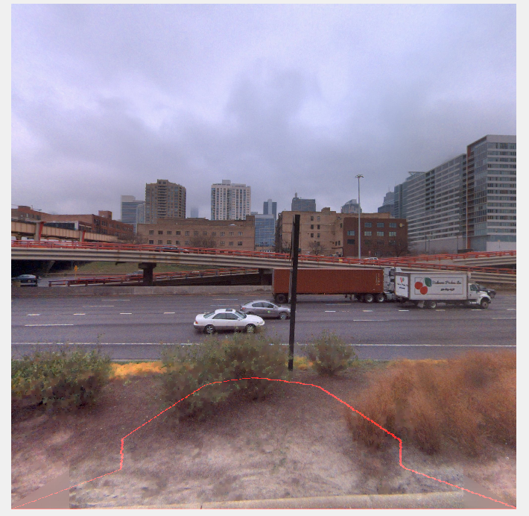
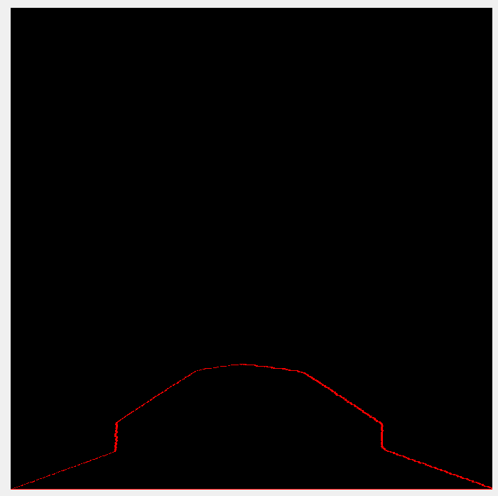
Process Demo

Slide 14
Results

Slide 15
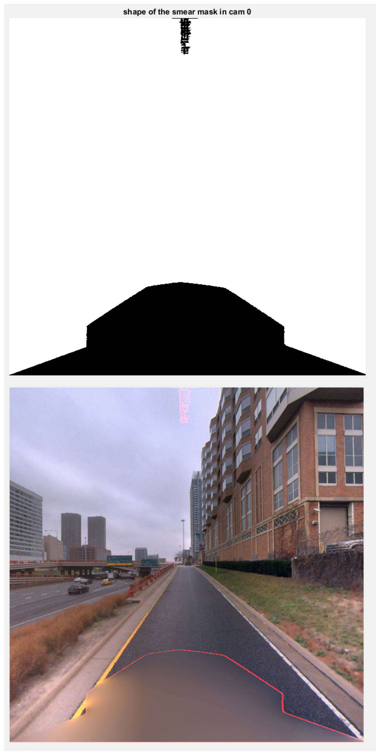
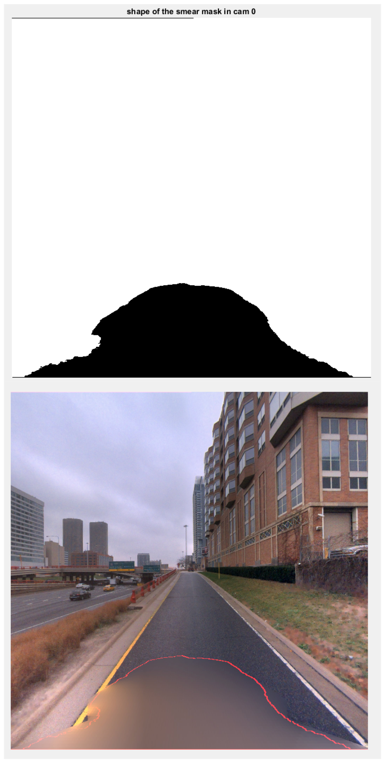

Method 1
Method 2
Method 3

Slide 16
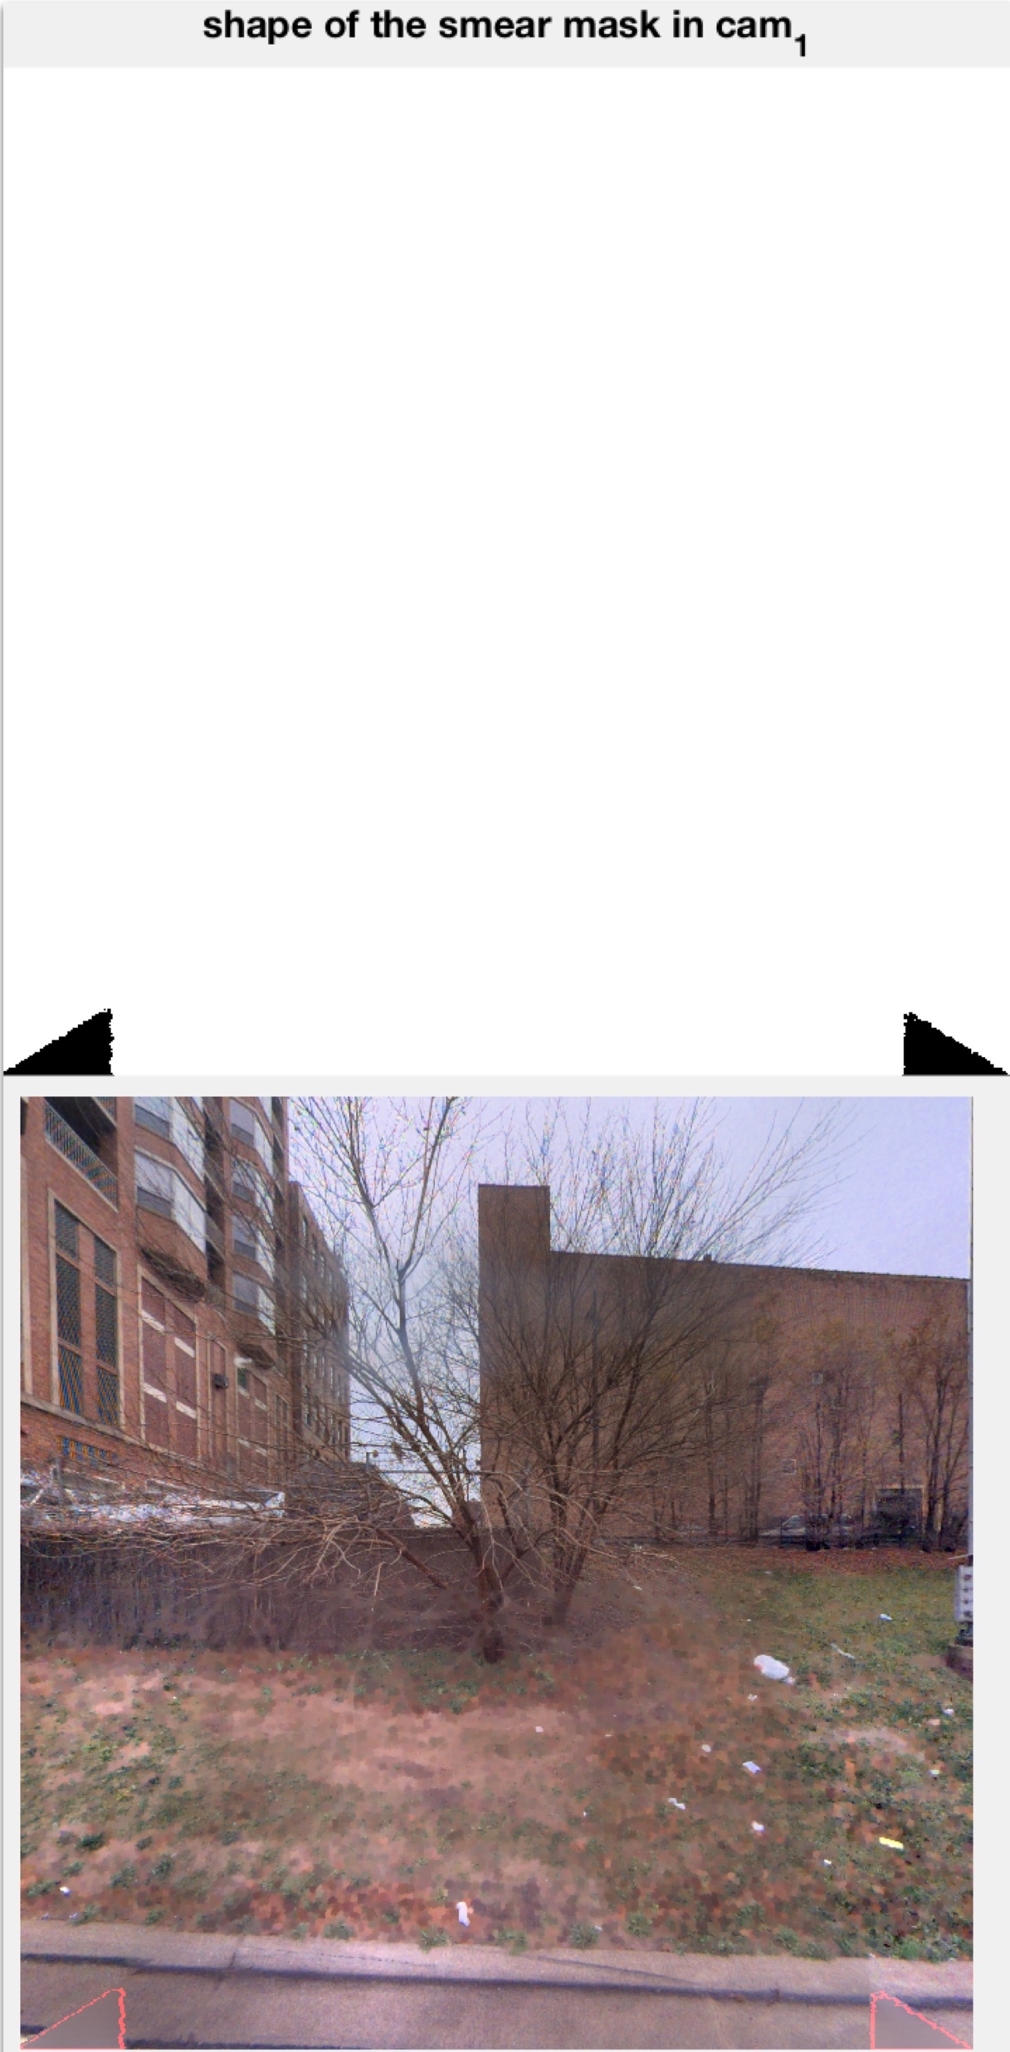
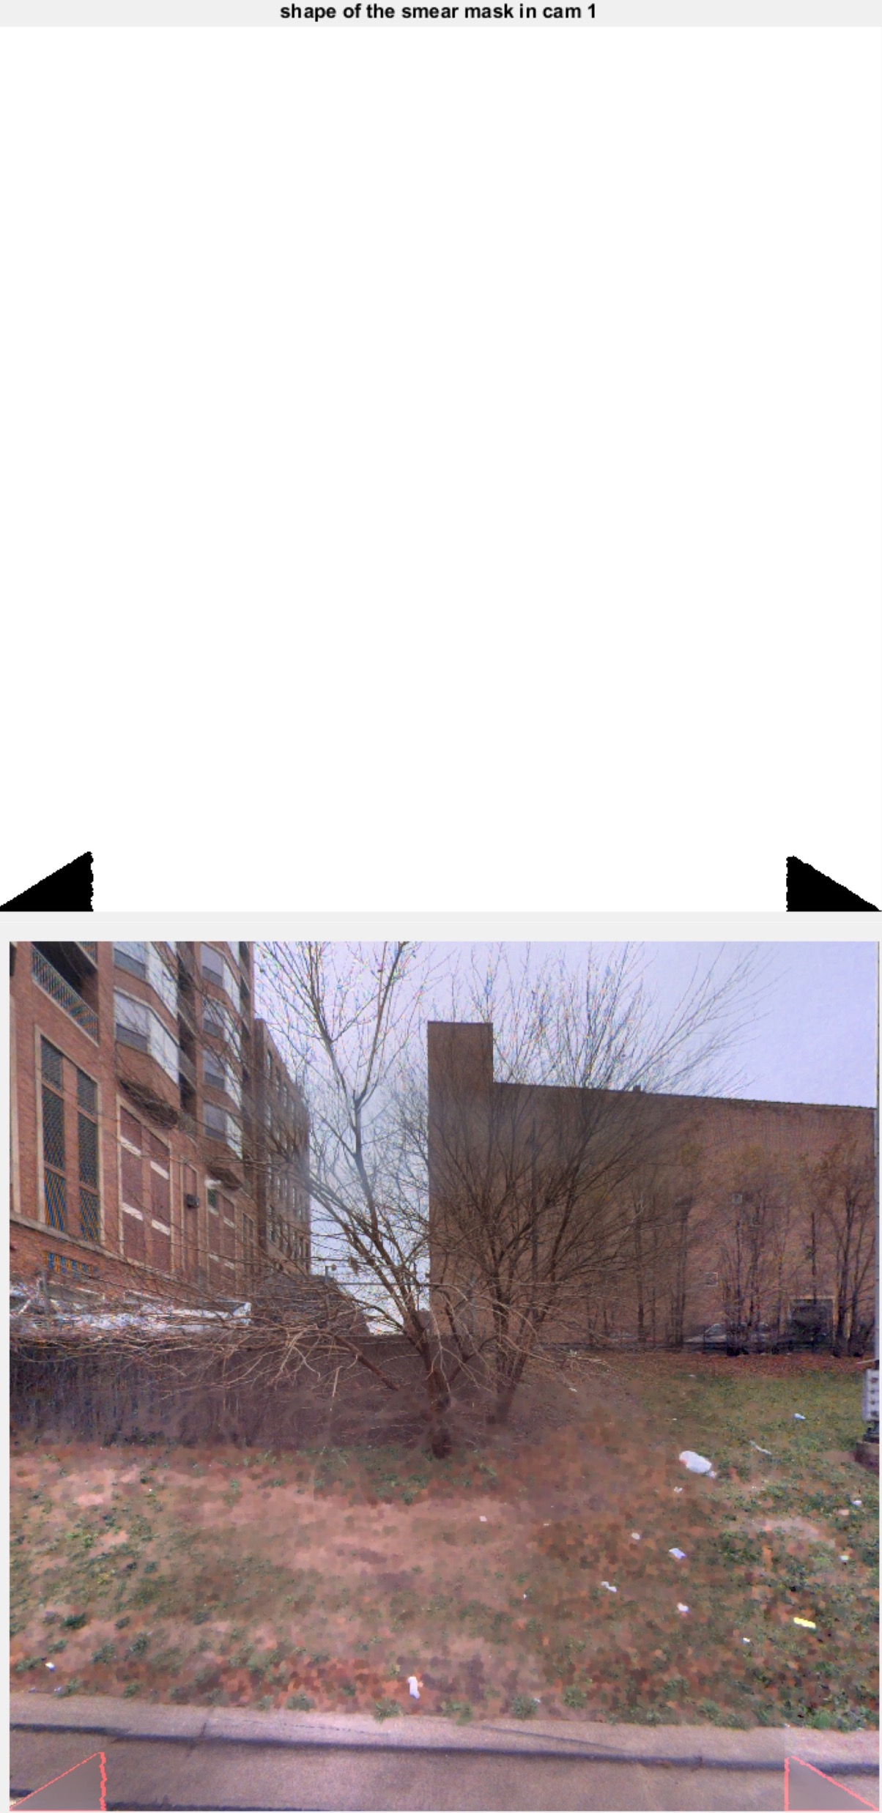
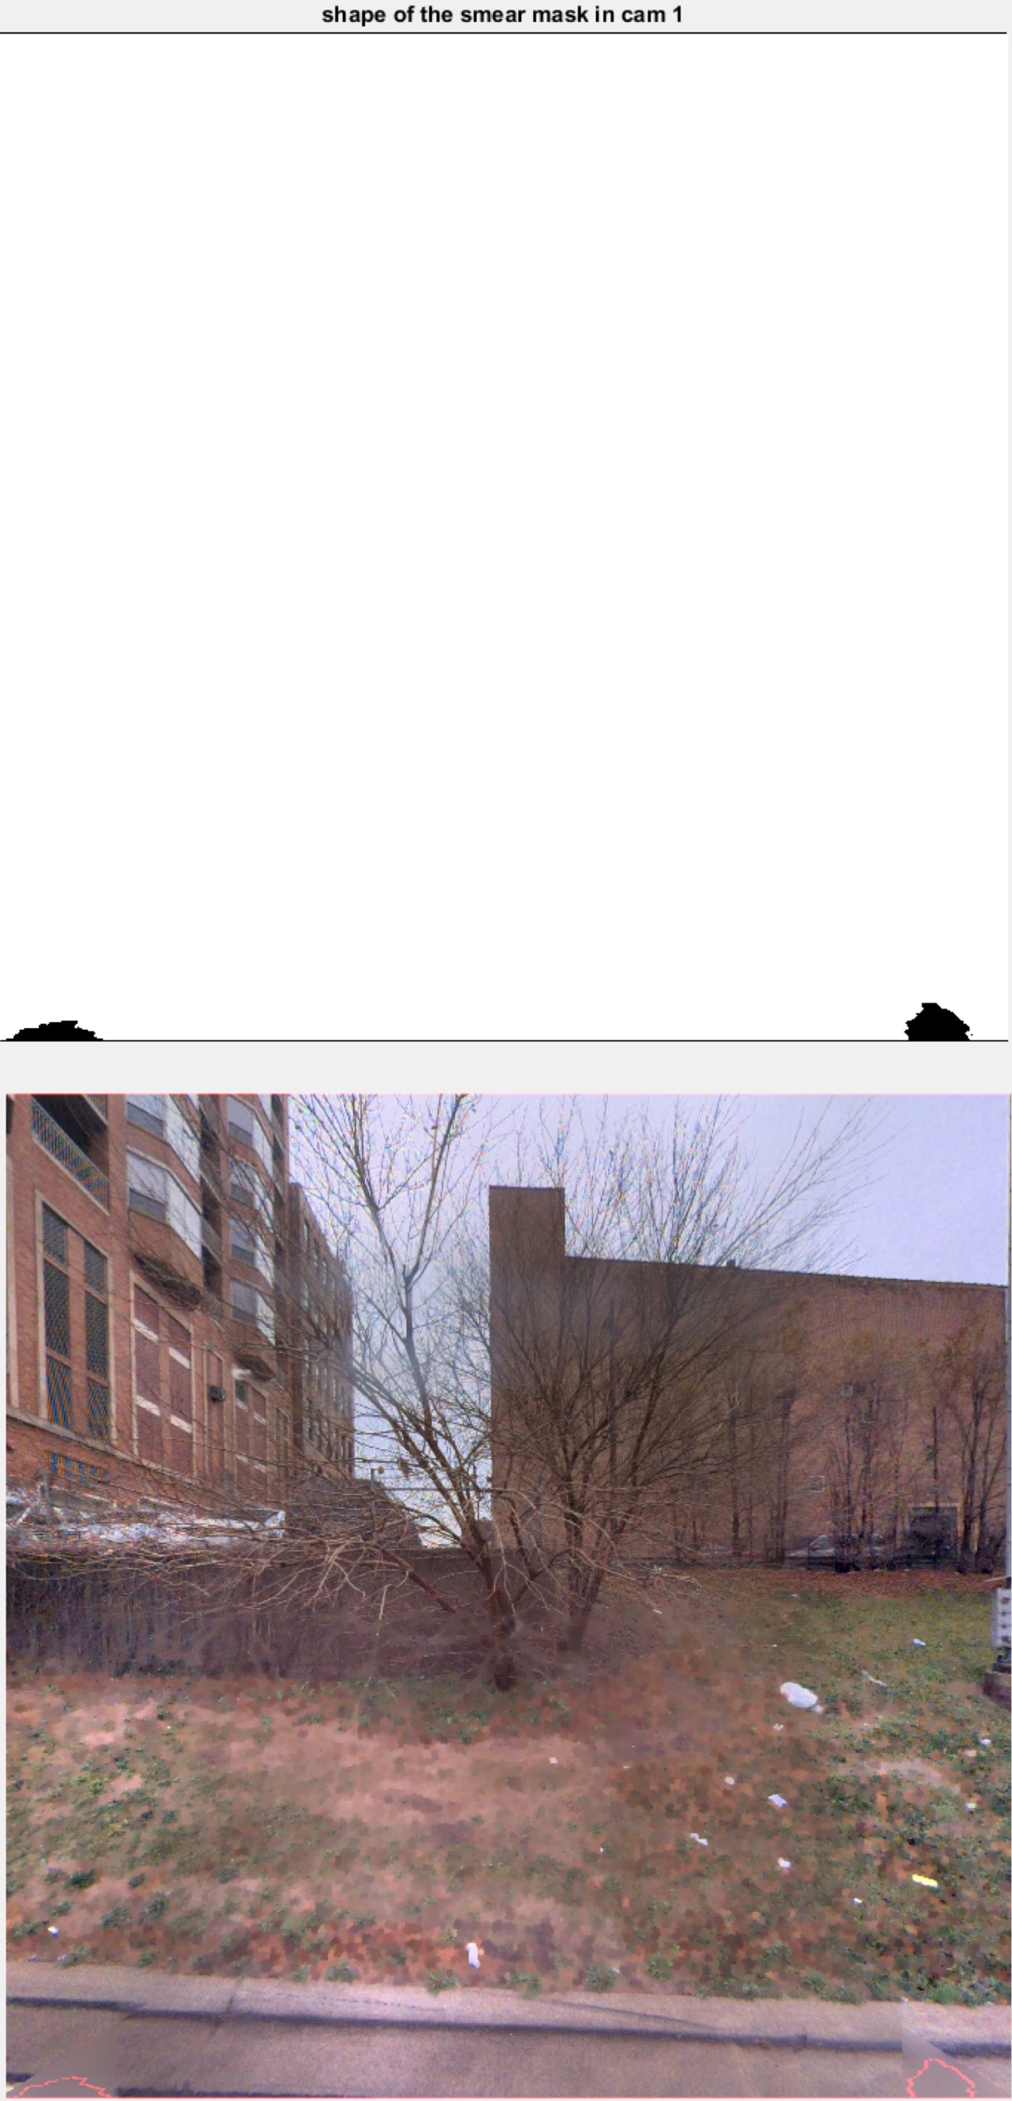
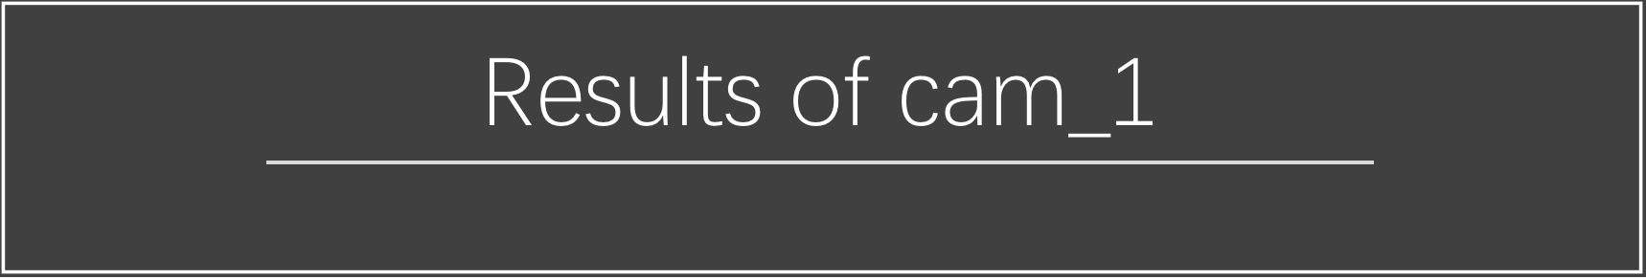
Method 1
Method 2
Method 3

Slide 17
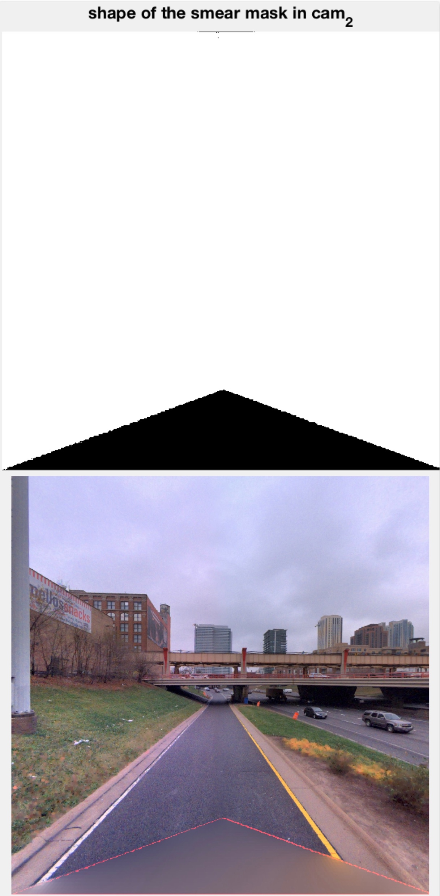
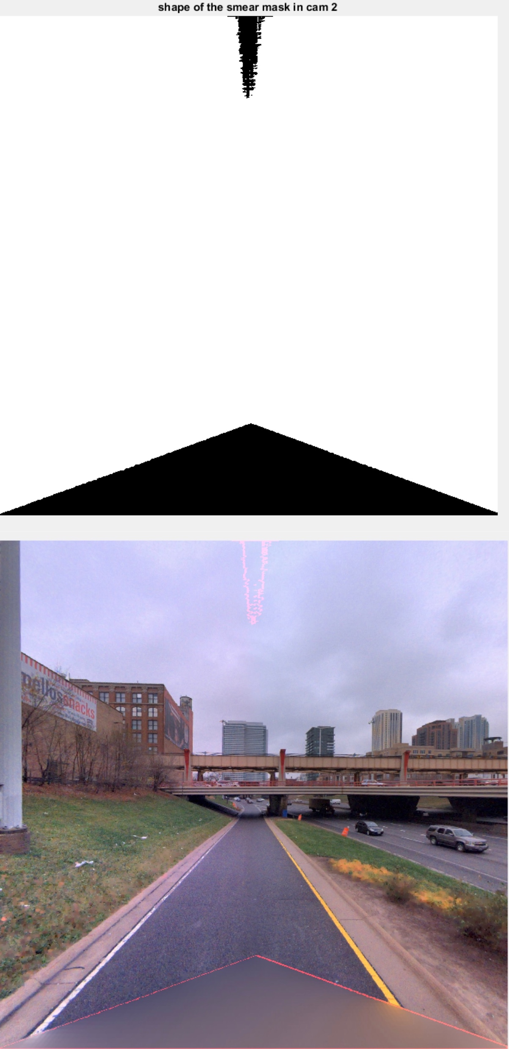
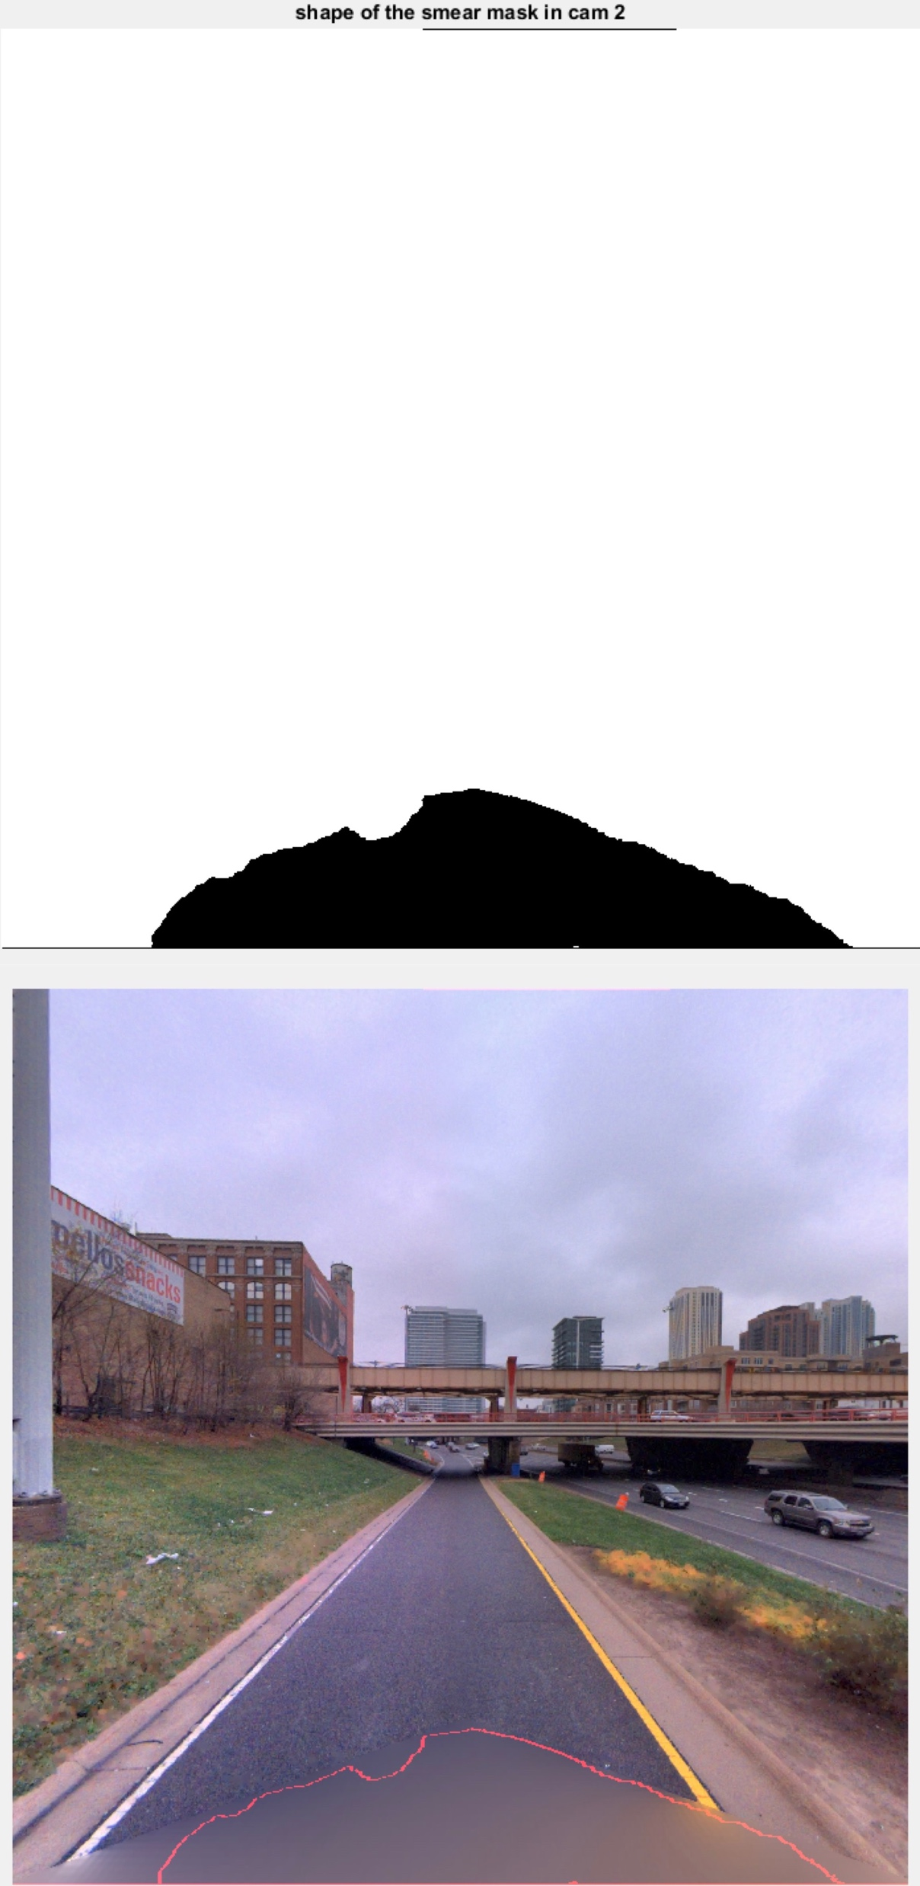
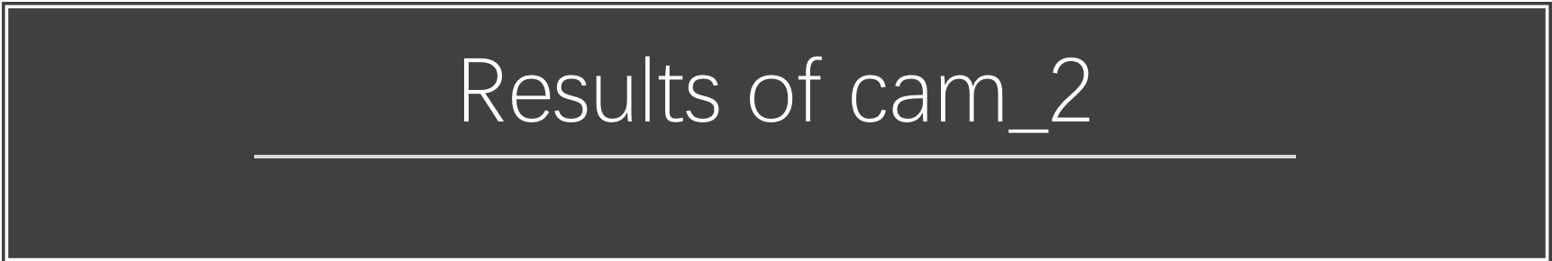
Method 1
Method 2
Method 3

Slide 18
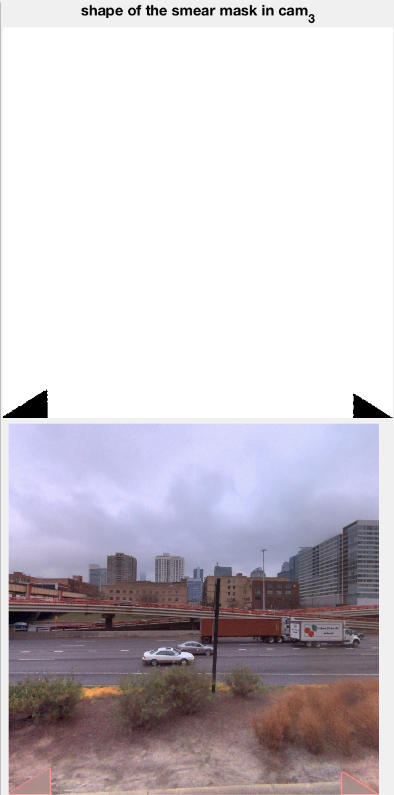
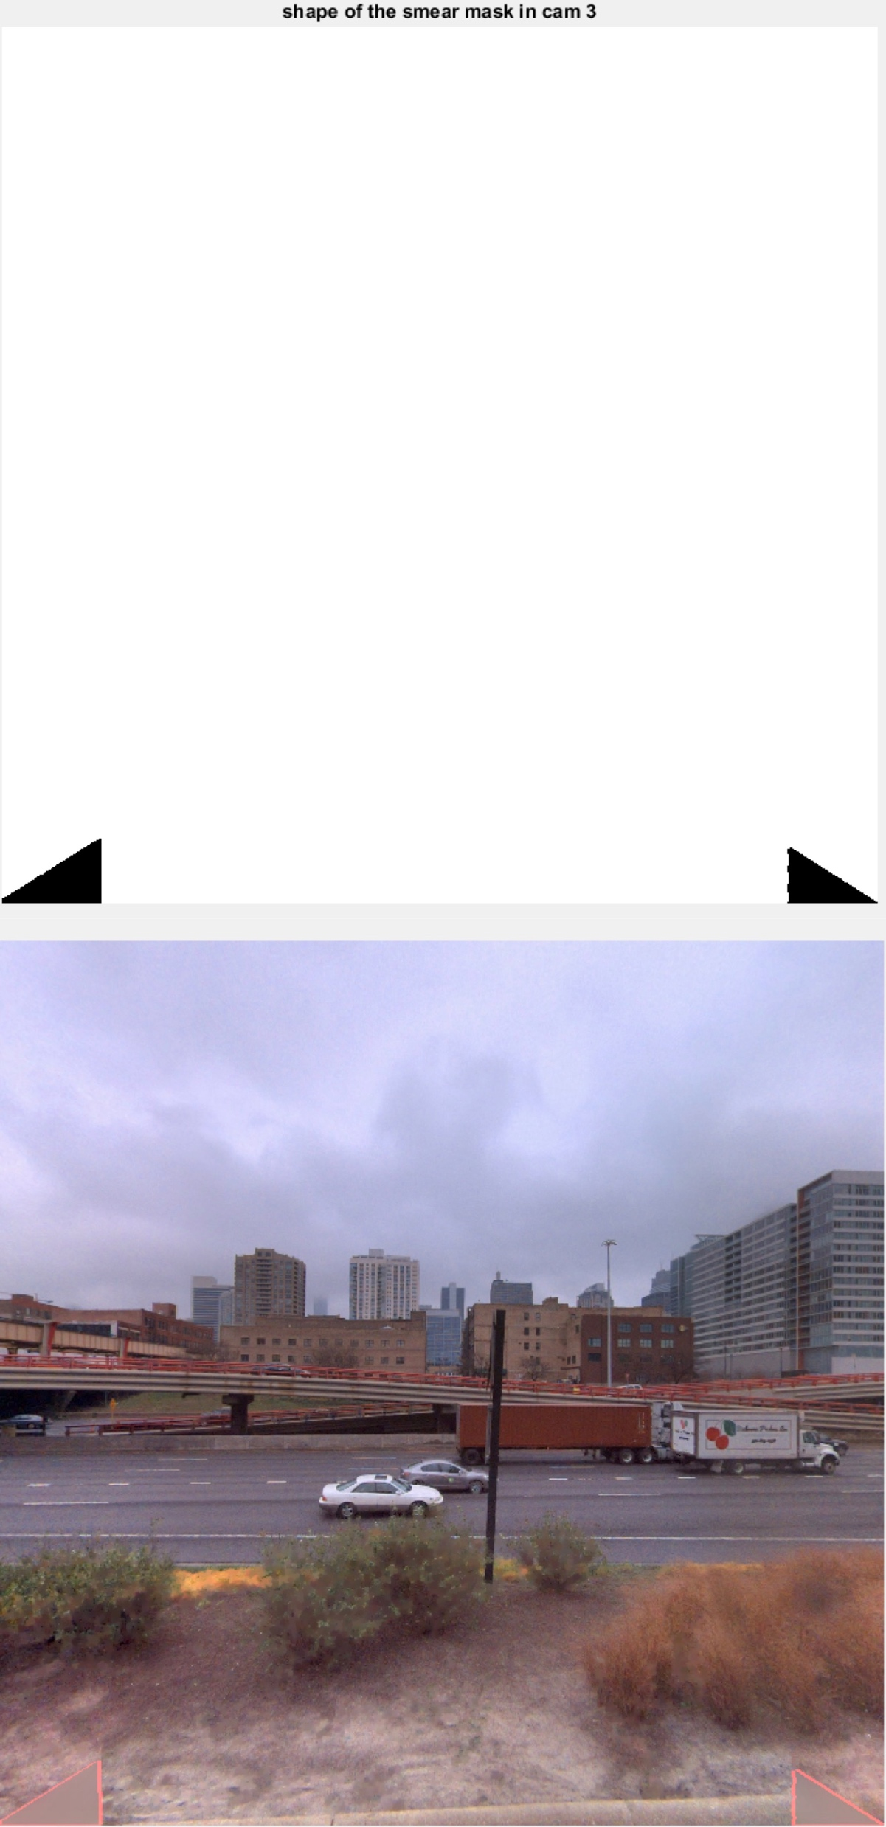
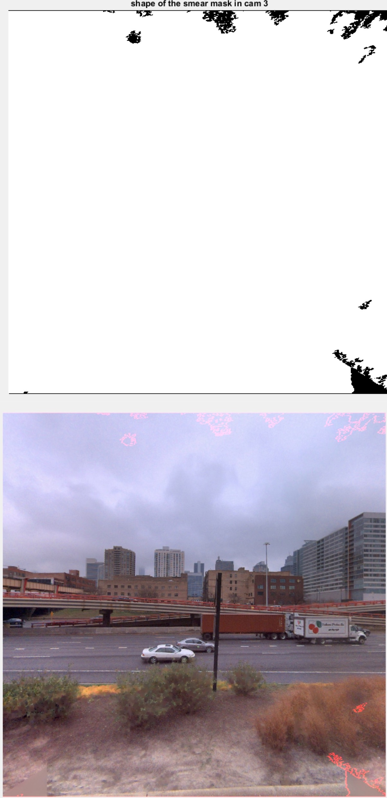

Method 1
Method 2
Method 3

Slide 19
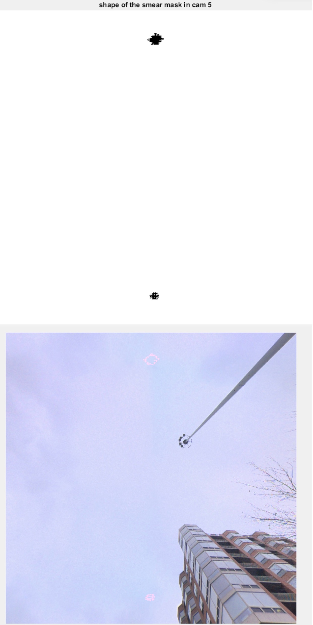
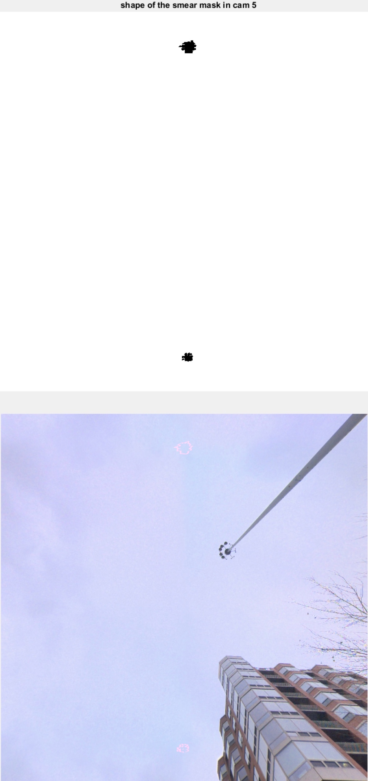
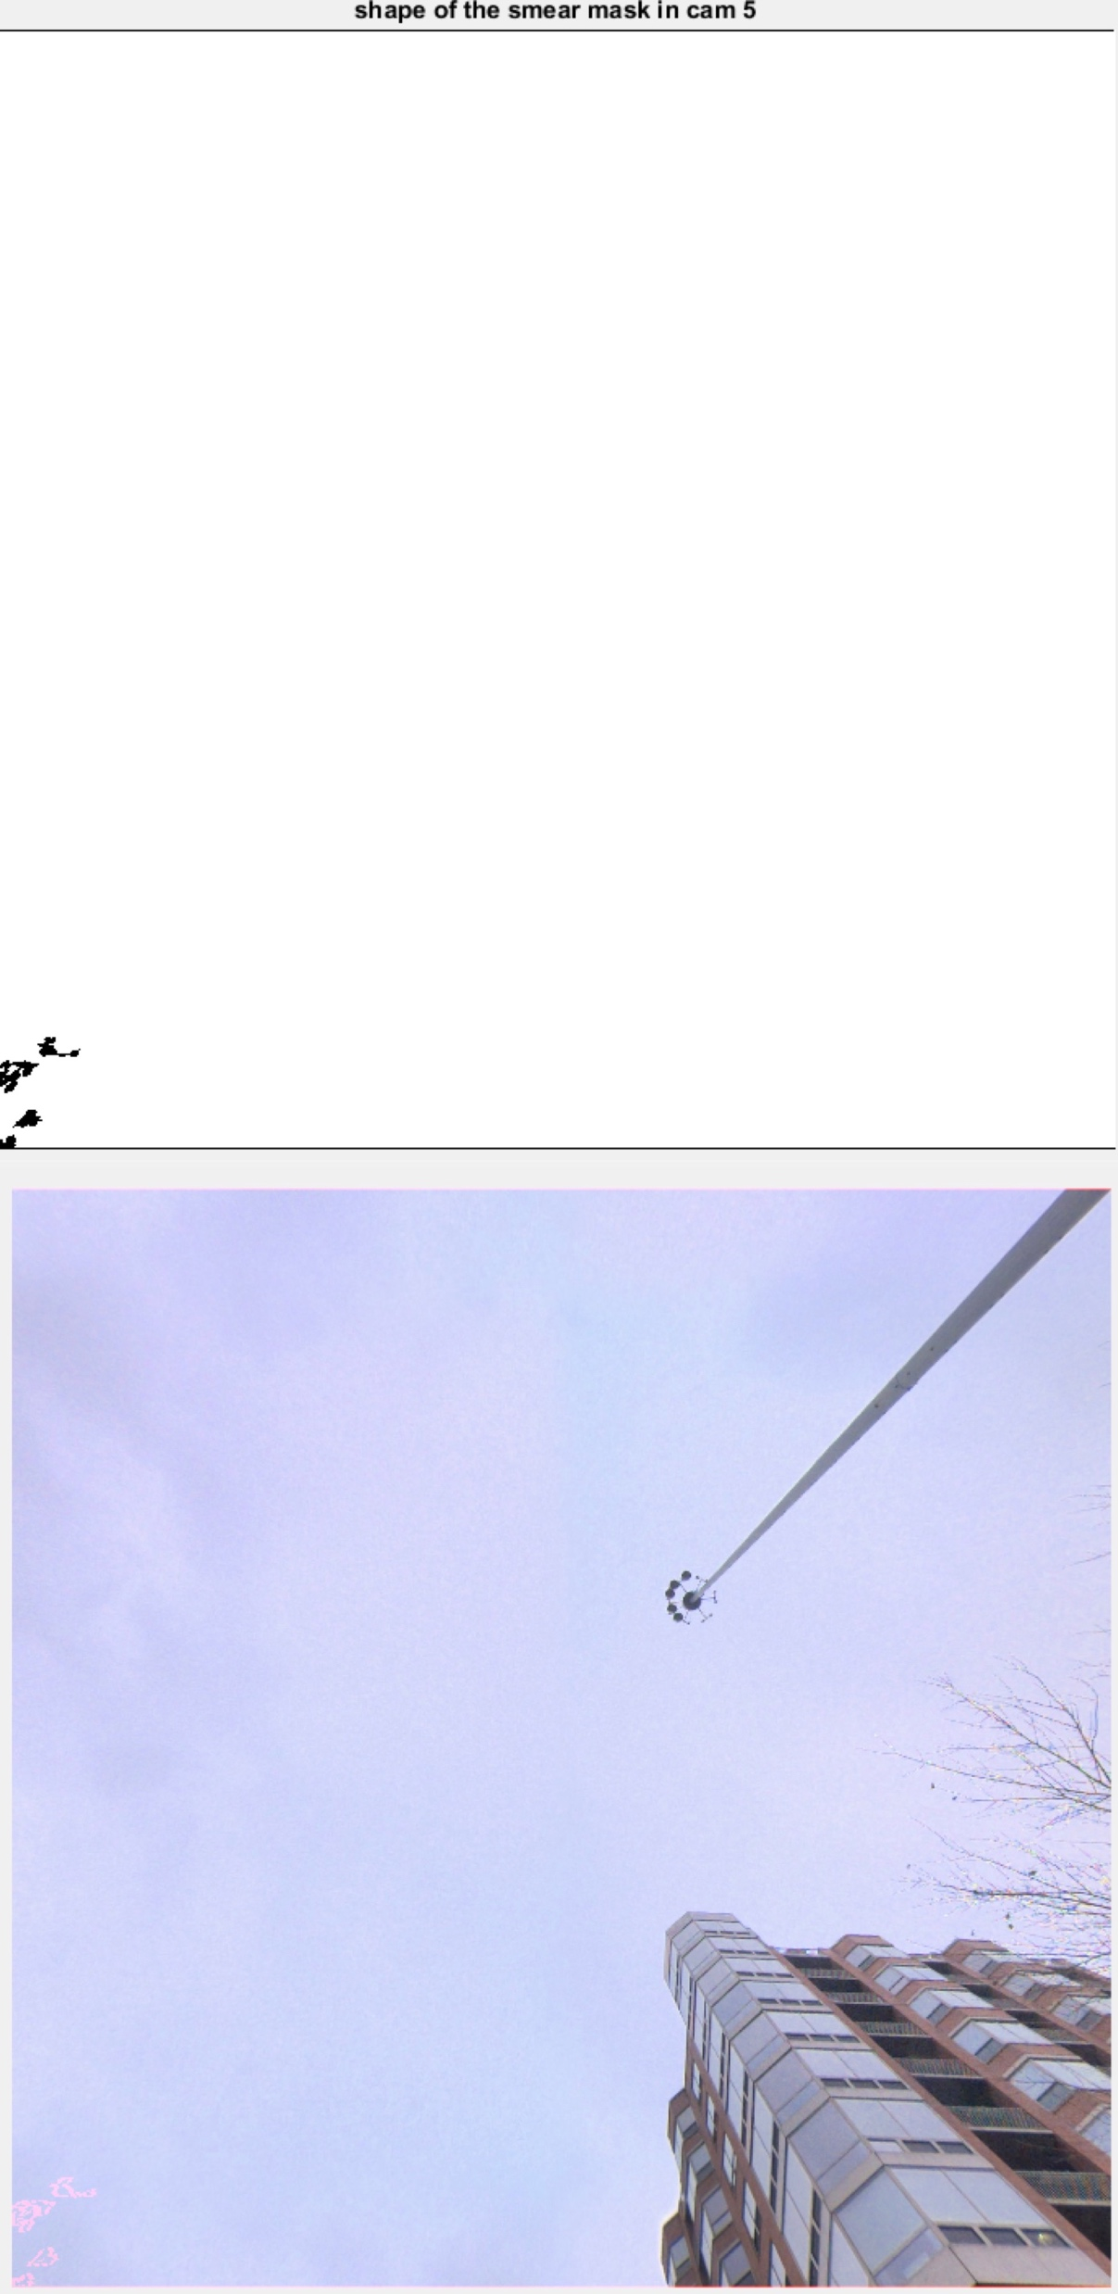

Method 1
Method 2
Method 3

Slide 20
Thanks!

